Slide 1


Slide 2


Skill Scholar
Second Year Project
Submitted by
ROLL | NAME
2301010028 | Vikrant Singh
2301010013 | Shubham Sinha
Industry Mentor: Parth Kotecha, Senior Software Engineer, Walmart Global Tech
Faculty Mentor: Dr. Meenu, Associate Professor, K.R. Mangalam University
Notes:
New Courses replaced with New Programmes

Slide 3

About the Problem
Problems Identified
Many students don’t know about the scholarships they can apply for because the information is scattered everywhere.
Searching for scholarships takes a lot of time, and most students don’t even know where to start.
Some scholarships have confusing eligibility rules, and students often miss deadlines because they don’t get proper reminders.
Notes:
New Courses replaced with New Programmes

Slide 4
About the Problem
Issues or Problems
Too much effort needed – Students have to check multiple websites, fill out long forms, and still might not find the right scholarship.
No proper guidance – Many students don’t have someone to help them understand which scholarship fits them best.
Hard to filter results – Most existing platforms don’t show scholarships based on a student’s specific needs.
Notes:
New Courses replaced with New Programmes

Slide 5
About the Problem
Need of Solution
There should be one simple platform where students can find all the scholarships they are eligible for.
The system should automatically suggest the best scholarships based on their details.
Students should get reminders before deadlines so they don’t miss out.
The platform should be easy to use for all students.
Notes:
New Courses replaced with New Programmes

Slide 6
About the Problem
Existing Solution
Government and college websites – They list scholarships, but they are hard to navigate, and students have to search everything manually.
Other scholarship websites – Many don’t provide correct or updated information, and some don’t have proper filters.
Teachers and counselors – They help students, but they can’t guide everyone individually, and their knowledge is sometimes limited.
Notes:
New Courses replaced with New Programmes

Slide 7
Problem Statement
Problem:
Many students struggle to find the right scholarships that match their unique needs, like merit-based, need-based, or field-specific opportunities.
Why it’s a problem:
The education system is becoming more expensive, and many students miss out on scholarships just because they don’t know where to look or which scholarships they’re eligible for.
This is especially challenging for students from less privileged backgrounds, who may not have access to the resources or guidance they need.
Notes:
New Courses replaced with New Programmes

Slide 8
Problem Statement
Why is it important ?
Access to Education: Without the right support of Scholarships, students might not pursue their academic dreams or may drop out due to financial strain.
Reducing Inequality: This platform can help bridge the gap for students who are disadvantaged, ensuring they don’t miss out on opportunities simply because they lack information.
Efficiency: By centralizing all available scholarships and making the application process easier and more personalized, SkillScholar saves students time and frustration, allowing them to focus more on their studies.
Notes:
New Courses replaced with New Programmes

Slide 9
Problem Statement
Expected impact of solving this problem
More Scholarships for More Students: If students have easy access to scholarships tailored to their needs, they can secure more funding for their education.
Boost in Graduation Rates: Financial concerns are one of the biggest reasons students drop out. By reducing these concerns, SkillScholar could contribute to better graduation rates.
Notes:
New Courses replaced with New Programmes

Slide 10
Objectives
Main goal of the SkillScholar
Centralized Scholarship Platform – One-stop solution for students to find all scholarships in one place.
Collaboration with Institutions – Connecting students with universities, NGOs, and funding organizations.
Personalized Scholarship Matching – AI-driven recommendations based on student profiles and eligibility.
Increased Accessibility – Ensuring students from all backgrounds can easily discover relevant scholarships.
Notes:
New Courses replaced with New Programmes

Slide 11
Methodology, Tools, and Techniques
Approach taken to solve the problem
Step 1: Research & Data Collection – Gather data on available scholarships from government portals, universities, and NGOs.
Step 2: Categorization & Filtering – Organize scholarships based on eligibility criteria, fields of study, and financial needs.
Step 3: AI-Powered Recommendation System – Implement machine learning algorithms to match students with the most suitable scholarships.
Step 4: User-Friendly Interface – Develop an intuitive platform with easy navigation and application tracking.
Notes:
New Courses replaced with New Programmes

Slide 12
Methodology, Tools, and Techniques
Tools, software, and techniques used
Frontend Development: html, tailwind css
Backend Development: Node.js, Express.js (for handling user requests efficiently)
Database: MongoDB/MySQL (to store scholarship and user data securely)
Machine Learning: Python (for AI-based scholarship matching)
Cloud Hosting: AWS/GCP (for scalability and secure data storage)
API Integration: Third-party education portals for fetching updated scholarship data
Notes:
New Courses replaced with New Programmes

Slide 13
Methodology, Tools, and Techniques
Justification for chosen methods
AI-Based Matching – Ensures students get the most relevant scholarships, reducing manual search time.
Modern Tech Stack (Node.js, MongoDB) – Ensures speed, scalability, and efficiency.
Cloud-Based Solution – Provides secure, 24/7 accessibility for students and institutions.
Automated Alerts & Tracking – Helps students stay updated on deadlines and application statuses.
Notes:
New Courses replaced with New Programmes

Slide 14
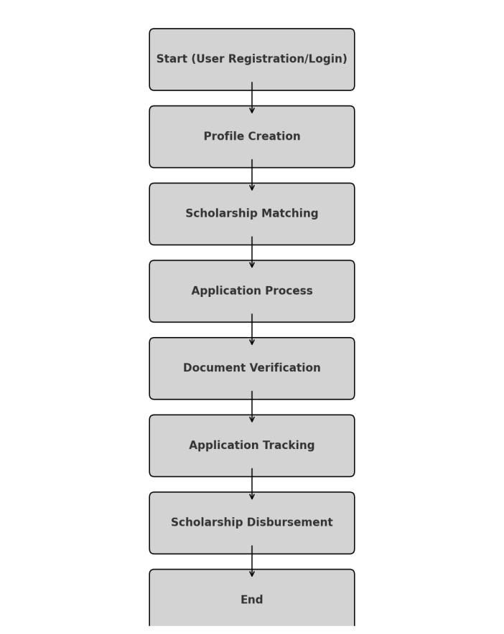
Methodology Flowchart
Notes:
New Courses replaced with New Programmes

Slide 15
Methodology Flowchart
Step | Representation | Description
Step 1 | Research & Data Collection | Collect data from government portals, universities, and NGOs about scholarships.
Step 2 | Categorization & Filtering | Organize scholarships based on eligibility criteria, field of study, and financial need.
Step 3 | AI-Powered Recommendation System | Implement Machine Learning to match students with scholarships best fitting their profile.
Step 4 | User-Friendly Interface | Develop a smooth, intuitive platform to display scholarships and allow application tracking.
Notes:
New Courses replaced with New Programmes

Slide 16
Expected Results & Impact
Expected Results:
Increased awareness and accessibility for students, especially those from underprivileged backgrounds.
Yes! It eliminates the complexity of manually searching for scholarships.
Ensures fair access by providing personalized scholarship suggestions based on the student’s profile.
Notes:
New Courses replaced with New Programmes

Slide 17
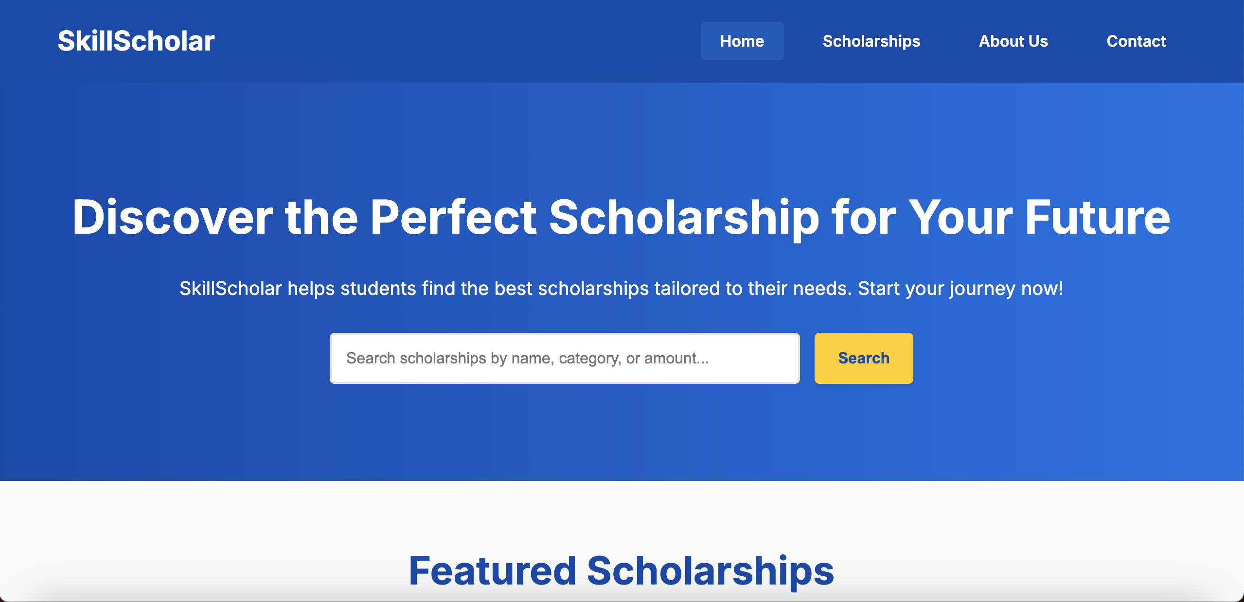
Expected Results & Impact
Prototype/ Working Model-
Notes:
New Courses replaced with New Programmes

Slide 18
Expected Results & Impact
Impact:
Bridging the education gap by making scholarships more accessible .
For Students: Hassle-free scholarship discovery and application, reducing financial stress.
For Universities & NGOs: A streamlined way to promote scholarships and reach deserving students.
Mobile App Development: Making the platform accessible anytime.
Integration with Universities & Government Portals: Real-time updates on new scholarships and funding programs.
Notes:
New Courses replaced with New Programmes

Slide 19
Experimental Setup (Hardware)
Processor: Intel Core i5 13th Gen (up to 4.2 GHz Turbo)
RAM: 16 GB DDR5, Storage: 512 GB PCIe NVMe SSD
Display: 15.6'' Full HD Anti-Glare
OS: Windows 11 Pro, Build 22H2
Minimal latency during load & blockchain verification
Notes:
New Courses replaced with New Programmes

Slide 20
Experimental Setup (Software)
Frontend: React.js, Tailwind CSS, Bootstrap 5
Backend: Node.js + Express.js
Database: MongoDB Atlas, Firebase Firestore
Blockchain: Hyperledger Fabric, Ethereum Testnet
Testing: OWASP ZAP, Postman, Docker, Kubernetes
Notes:
New Courses replaced with New Programmes

Slide 21
Evaluation Metrics
Metric | Target | Why it Matters | How it's Measured
Scholarship Matching Accuracy | ≥ 92% | High accuracy ensures students are shown scholarships truly relevant to them. | Correct matches ÷ Total matches predicted
Precision | ≥ 90% | Measures how many scholarships suggested were actually correct (avoiding wrong suggestions). | True Positives ÷ (True Positives + False Positives)
Recall | ≥ 88% | Measures how many of the actually eligible scholarships the system was able to find (avoiding misses). | True Positives ÷ (True Positives + False Negatives)
Response Time | ≤ 2 seconds | Students expect fast search results. A slow system discourages users. | Average time from search query to scholarship results display.
Platform Uptime | ≥ 99.5% | Ensures students can access the platform anytime without facing downtime. | Tracked via monitoring tools like AWS CloudWatch.
Security | 0 Critical Vulnerabilities | Protects students' sensitive data like personal info, academic records. | OWASP ZAP Scans, Penetration Testing.
Notes:
New Courses replaced with New Programmes

Slide 22
Results
Aspect | Achieved Result | Significance
Precision | 91.8% | Very close to the target, meaning very few irrelevant scholarships are suggested.
Recall | 89.3% | Excellent recall - students are unlikely to miss eligible scholarships.
F1-Score | 90.5% | Balanced between Precision and Recall, confirms strong matching capability.
Response Time | 1.7 seconds | Faster than the target (2s) → Excellent user experience.
Dashboard Load Time | 2.1 seconds | Smooth backend performance even for complex dashboards.
Concurrent Users Supported | 500 users | The system can handle a good number of simultaneous students without crashing.
User Satisfaction | 94% | Surveyed students found the platform helpful and easy to use.
Notes:
New Courses replaced with New Programmes

Slide 23
Results
Aspect | Target | Achieved Result | Meaning/Impact
System Usability Score (SUS) | > 85 (Excellent Usability) | 88.7/100 | Platform is highly usable , users are satisfied and confident.
Security (OWASP ZAP Scan) | 0 Critical Vulnerabilities | 0 Critical Vulnerabilities | System is highly secure, no major security risks detected.
Blockchain Verification | 100% Document Verification | 100% Success | Ensures transparent, tamper-proof scholarship applications and records.
GDPR Compliance (Data Deletion Time) | Data deletion within 48 hours after request | Achieved (within 48 hours) | Platform respects users' data privacy rights and follows international data protection laws.
Notes:
New Courses replaced with New Programmes

Slide 24
Conclusion
Centralized 5000+ active scholarships
AI-Personalized recommendations
Blockchain-based document transparency
User-friendly, accessible platform
Notes:
New Courses replaced with New Programmes

Slide 25
Future Work
Step | Work | Description
Plan 1 | Mobile App Launch | Android/iOS app for easy access.
Plan 2 | Global Scholarship Expansion | Include scholarships from outside India.
Plan 3 | Multilingual Support | Different languages for better accessibility.
Plan 4 | Zero Trust Security | Advanced security upgrades for data safety.
Notes:
New Courses replaced with New Programmes

Slide 26
THANK YOU

